Slide 1
DATA SCIENCE
The ever-evolving world
of
Creation and working of a Book Recommendation System
Team Members
Sonal Shabir – RA2011027010010
Prakhar Srivastava – RA2011017010013
Shreya Dutta - RA2011027010033

Slide 2
INTRODUCTION
What is a Recommendation System?
Subclass of machine learning which deals with ranking or rating products/users.
Predicts ratings a user might give to a specific item which will then be ranked and returned to the user.
For example, Spotify recommends songs similar to the ones you’ve repeatedly listened to or liked so that you can continue using their platform to listen to music.

Slide 3
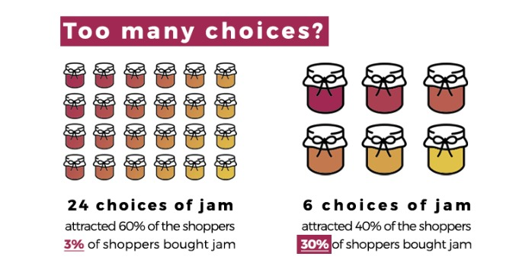

Slide 4

APPLICATION AREA
E- Commerce
Rating is a common function in e-commerce systems. Using these ratings, we recommend our users certain books based on his or her interests and preferences.
, most searched, etc.

Slide 5
PROBLEM STATEMENT AND APPROACH
Now-a-days, online rating and reviews play an important role in book sales. Readers buy books depending on choices made by other customers. Our Recommendation system focuses on these reviews and ratings by others and filters books according to the user’s preferences.
Here, we have employed the concept of Collaborative Filtering.
Books are recommended by the clustering model. We are going to train and build this model by using various features such as user’s ratings, book description, book titles, the number of views a book has received etc.
The system groups users into clusters so that each data point within the cluster is similar and dissimilar to the data point in the other cluster.
For example, let’s say we have a dataset consisting of 50 random books and if a customer wants to get recommendations on book A, our model will find the distance from said book to all the other books in the data set. It will then fetch the five least distances and will hence provide those books as recommendations to the user on the basis of reviews, genre and number of reads (i.e more than 200 reads)

